Slide 2
Quest 1
Subnet the Class C IP Address 206.16.2.0 so that you have 30 subnets.
What is the subnet mask for the maximum number of hosts?
How many hosts can each subnet have?

Slide 3
Solution
Current mask= 255.255.255.0
Bits needs for 30 subnets =5 =25 =32
possible subnets Bits left for hosts = 3 = 2^3 -2 = 8-2=6 possible hosts.
So our mask in binary =11111000= 248
decimal Final Mask =255.255.255.248 (3 marks) PA

Slide 4
2.
Subnet the Class C IP Address 195.1.1.0 So that you have 10 subnets each with a maximum 12 hosts on each subnet.?

Slide 5
Ans
Current mask= 255.255.255.0
Bits needs for 10 subnets =4 =2⁴ =16 possible subnets
Bits needs for 12 hosts = 4 = 2⁴ = 16-2=14 possible hosts.
So our mask in binary =11110000= 240 decimal
Final Mask =255.255.255.240

Slide 6
3.
Given the subnet Mask 255.255.255.192 What is the host address and subnet of the following IP address 197.1.2.67?

Slide 7
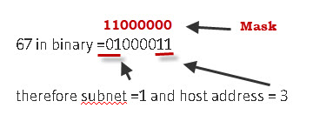
ans
192 in binary =11000000 gives 4 possible subnets of (showing 2 most significant bits):
00,01,10,11
67 in binary =01000011
So Applying Mask:

